Slide 1

Business Forecasting
Adrian Chan

Slide 2
Forecasting Question
What is the best method of forecasting Costco’s future revenues?
Notes:
- Important to me because of its impact in my life along with its unique business model that allows Costco to distinguish itself from some of its top competitors

Slide 3

Quarterly Costco Sales
The data that I collected were based on the SEC Edgar website that were submitted by Costco. I utilized their 10-Q and 10-K forms to find their quarterly sales and membership fees beginning from Q1 of fiscal year 2002 to Q3 of fiscal year 2024

Slide 4
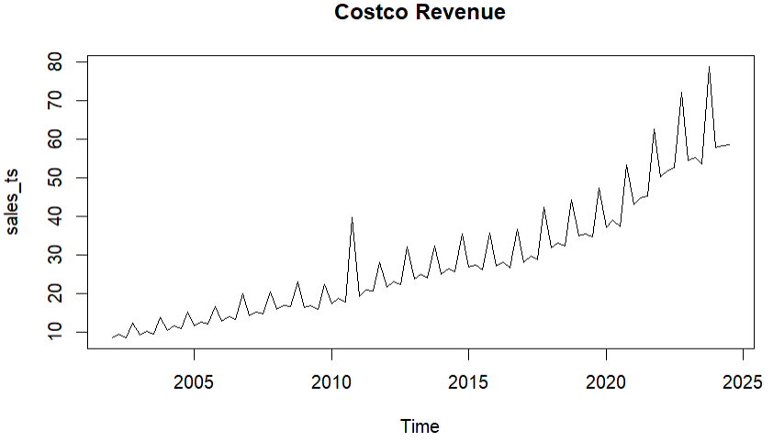
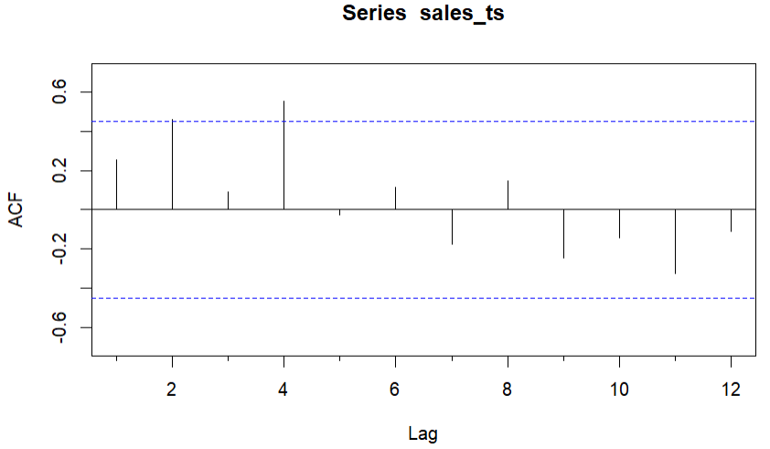
Exploratory Data Analysis
Data is seasonal
Sees a spike in revenue every Q4 of their fiscal year (during the summer)
Upward trend in revenue every year

Slide 5
Accuracy Measure
MAPE represents the best accuracy measure to use for forecasts
Gives the average absolute percentage error between actual and predicted values

Slide 6
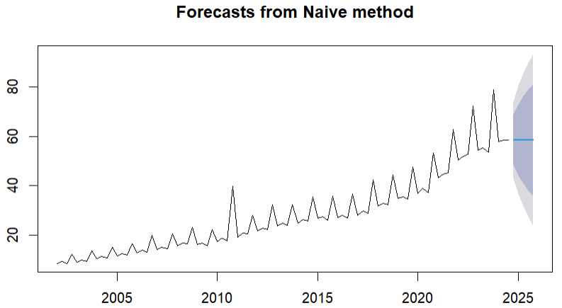
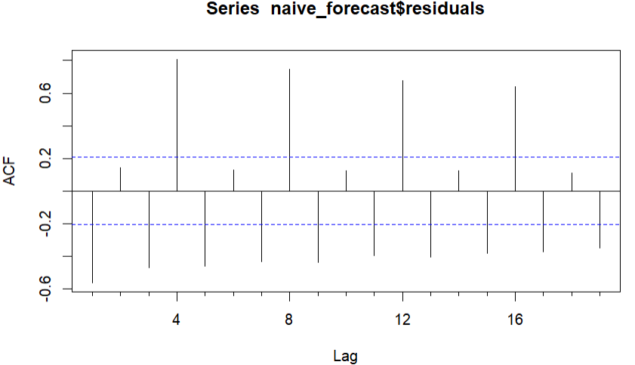
Naïve Forecasting
Predicts the next 5 quarters’ revenues as last quarter’s recorded value
Residual analysis shows multiple lags outside the significance bounds
Indicates that the forecast is inaccurate and is not taking into consideration aspects such as seasonality and/or trend

Slide 7
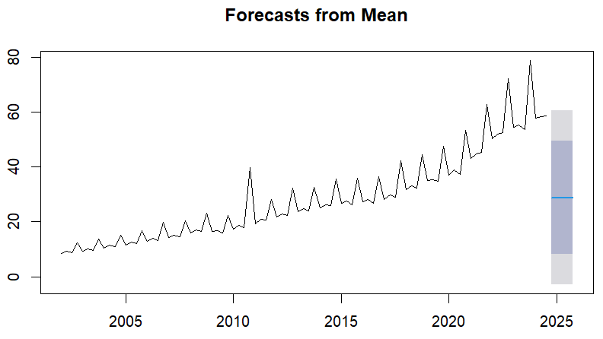
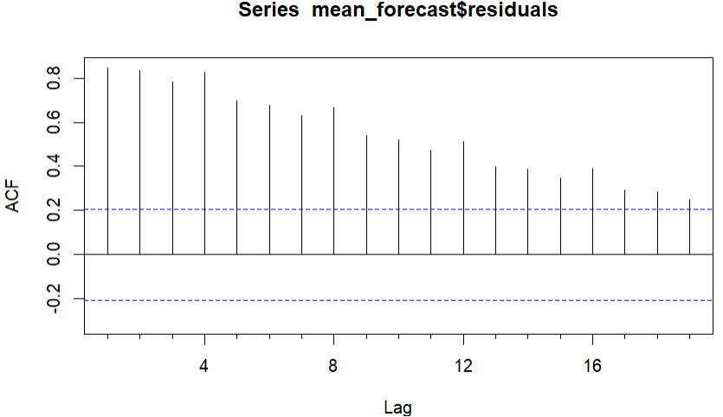
Mean Forecasting
Predicts the revenues of the next 5 quarters using the mean of the dataset
Residual analysis shows all lags outside of significance bounds
Forecast inaccurate and does not take into consideration the seasonal aspect of the data

Slide 8
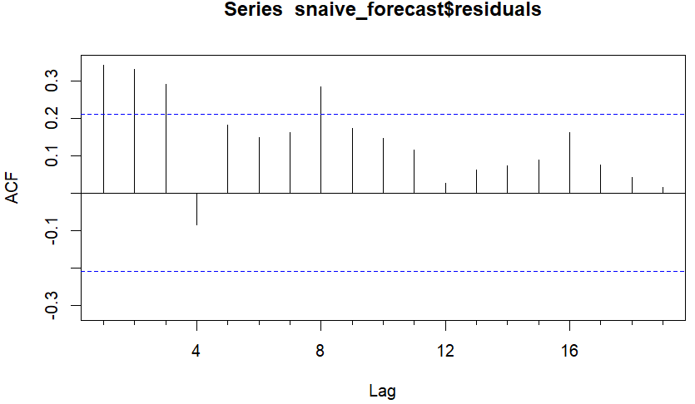
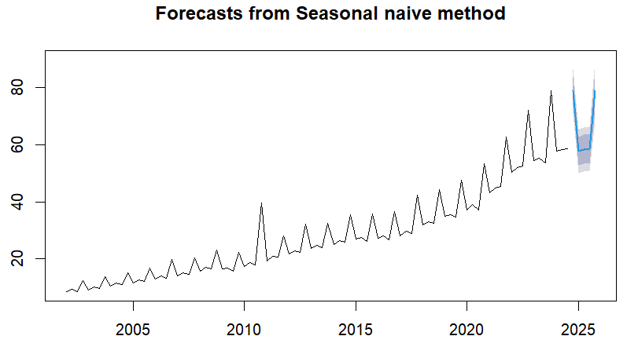
Seasonal Naïve Forecasting
Forecasts the revenues of the next 5 quarters using the seasonal naïve method
Much more accurate forecasting method than the regular naïve method and mean forecasting method as it accounts for seasonality
Residual analysis shows that most of the lags are within the significance bounds but the forecast can be much more accurate

Slide 9
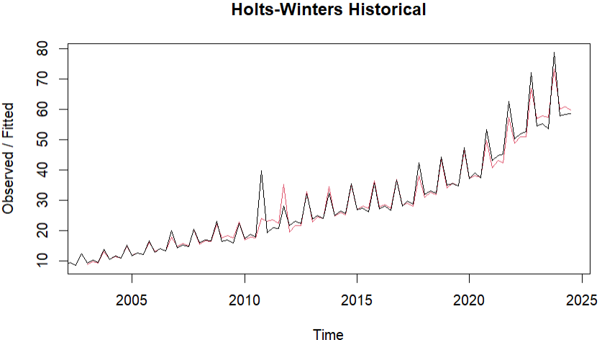
Holts-Winters (Historical)
Shows the forecasted values of the historical data in red using the Holts-Winters method compared to the actual values
Takes into account the seasonality aspect as evident by the spikes every Q4

Slide 10
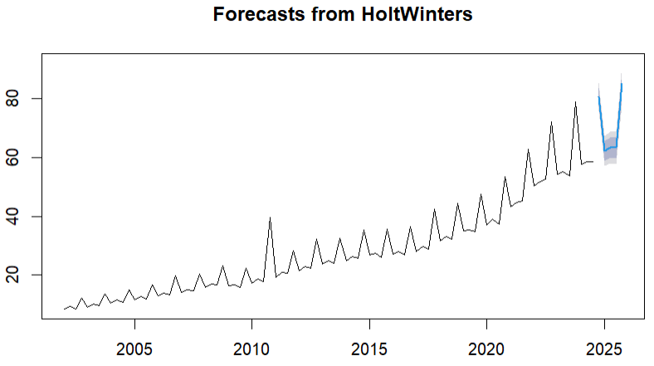
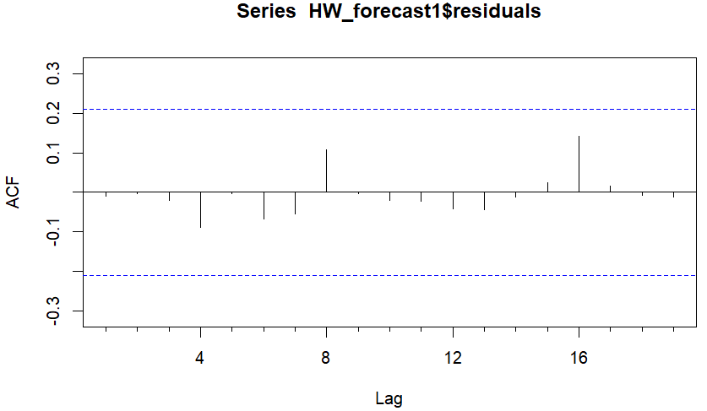
Holts-Winters Forecasting
Forecasts the next 5 quarters using the Holts-Winters method
The most accurate measure used so far while taking seasonality into account
Residual analysis of this method shows all the lags within the significance bounds
Indicates a fairly accurate forecast and is the method of choice as of right now

Slide 11
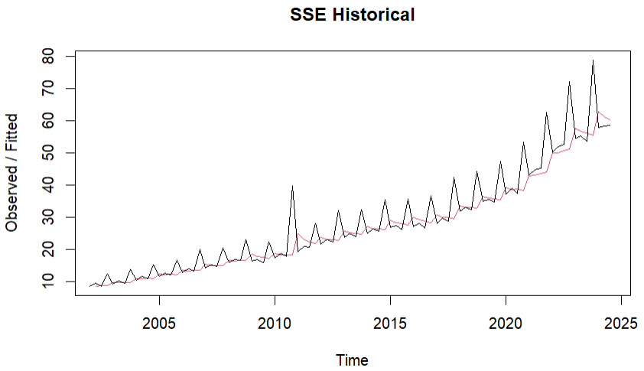
Simple Smoothing (Historical)
Shows the forecasted values of the historical data in red using the Simple Smoothing method compared to the actual values in the dataset
Not as accurate as Holts-Winters as it does not include the beta or the gamma (seasonality)

Slide 12
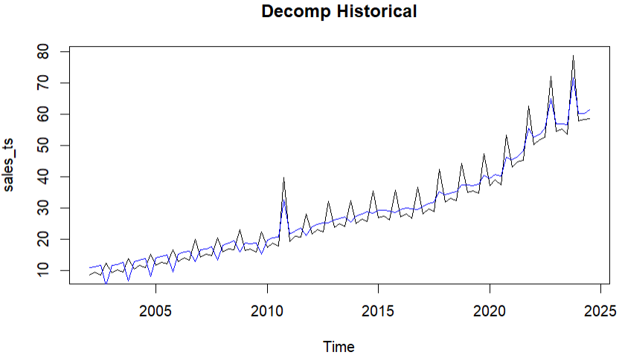
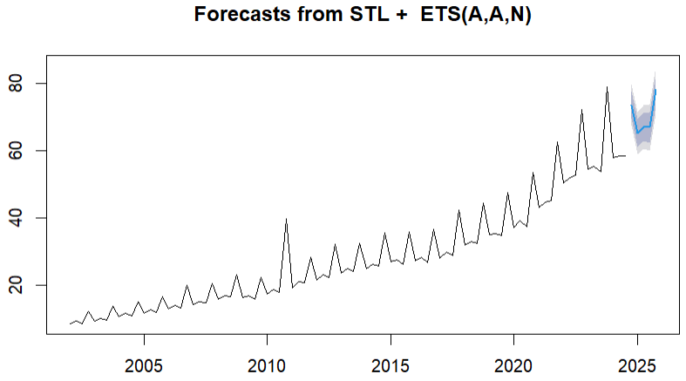
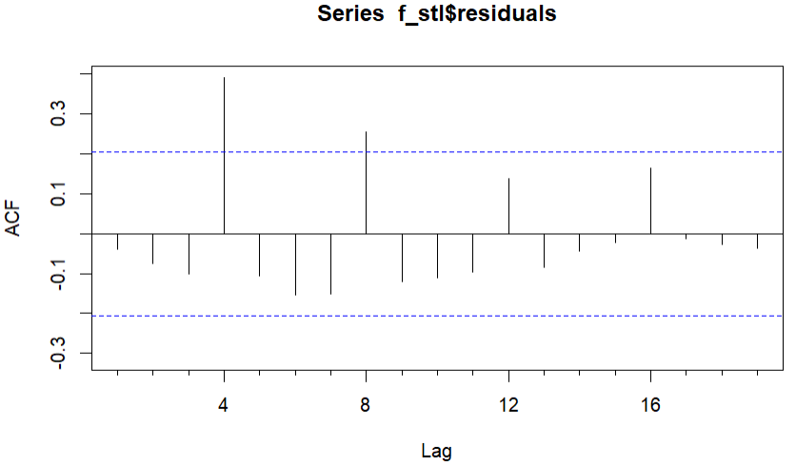
Decomposition
Shows the forecasted values of historical data in blue using Decomposition compared to the actual values in the dataset
While it does take into consideration some seasonality, it is still not as accurate as Holts-Winters
Residual analysis shows a couple lags outside the significance bounds, meaning a better method can be used to accurately forecast the revenues

Slide 13
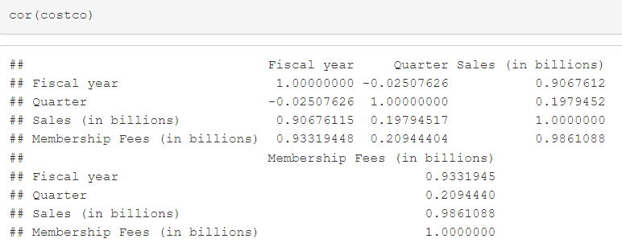
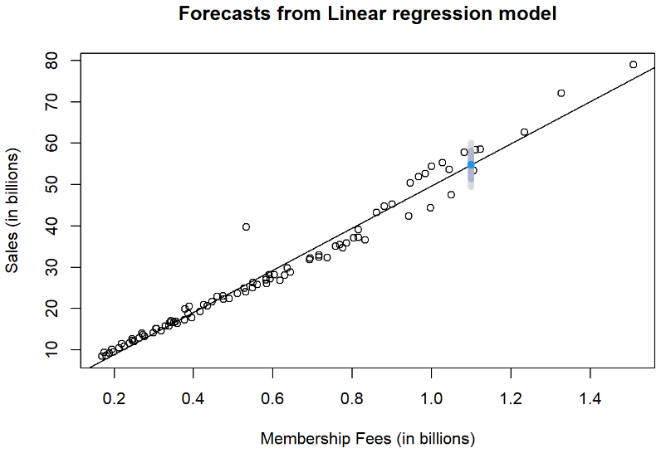
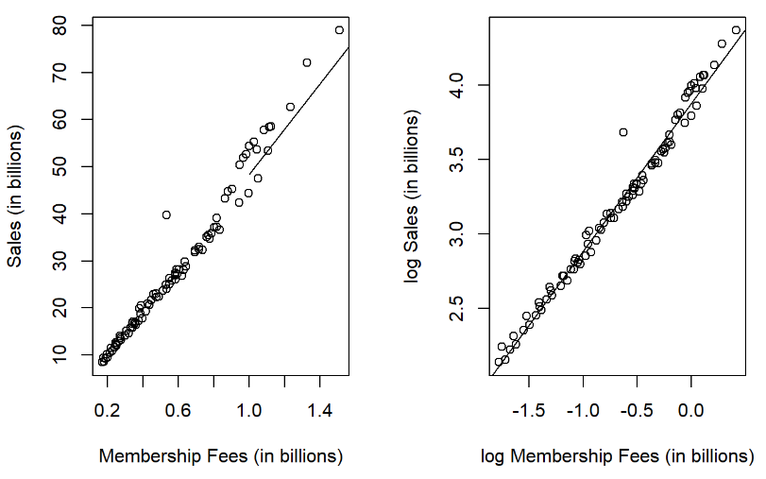
Regression
Forecasts the sales (dependent variable) based on the membership fees (independent variable) using Regression
Can be seen that as the membership fees go up, so do the sales
Based on correlation matrix, membership fees are highly correlated with Costco’s sales
Increase in membership fees results in an increase in sales

Slide 14
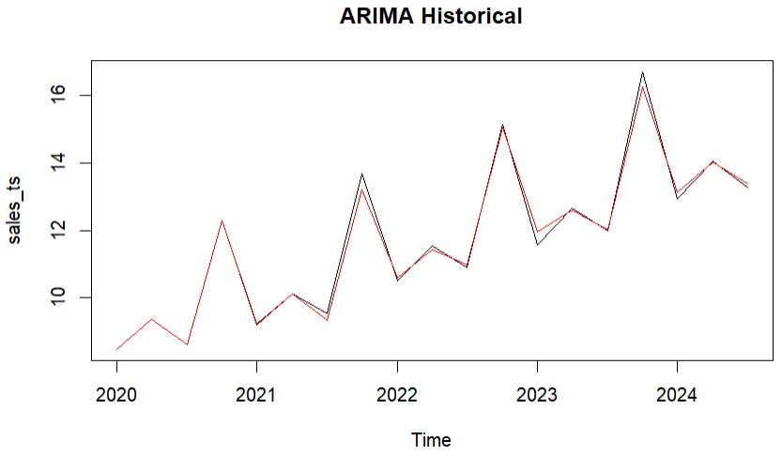
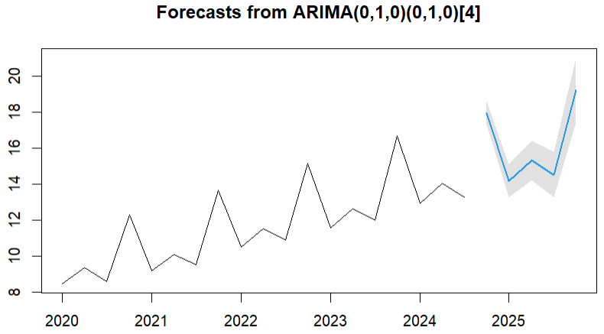
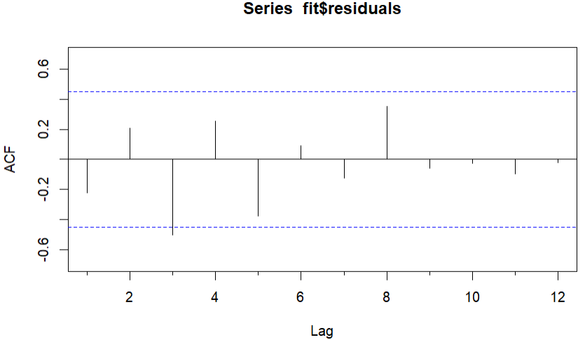
ARIMA Forecasting
Cut the data to start from Q1 2020
Shows the forecasted values of historical data in red using ARIMA compared to the actual values in the dataset (pretty accurate)
Forecasts the next 5 quarters using the best ARIMA model
Residual analysis shows only one lag outside the significance bounds
Mostly accurate but could be better

Slide 15

Decision
Using MAPE as the accuracy measure, ARIMA seems to be the method that provides the best forecast for Costco’s future revenues
Utilizes more recent historical data to forecast next 5 quarters’ worth of revenues
MAPE of 0.9580384 compared to second most accurate method in Holts-Winters of 4.281328
Lower MAPE indicates more accurate forecast

Slide 16
Improvements
Use more recent data to reduce noise
Utilize the same amount of data for all forecasting methods

